Slide 1
Cloud Computing
SEWP ZG527

Slide 2
Introduction to Cloud Computing, services and deployment models
Agenda
Introduction to Cloud Computing – Origins and Motivation
3-4-5 rule of Cloud Computing
Types of Clouds and Services
Cloud Infrastructure and Deployment

Slide 3
Motivation
Powerful multi-core processors
General purpose graphic processors
Superior software methodologies
Virtualization leveraging the powerful hardware
Wider bandwidth for communication
Proliferation of devices
Explosion of domain applications
Web Scale Problems
Web 2.0 and Social Networking
Information Explosion
Mobile Web
Notes:
RL 1.1

Slide 4
Evolution of Web
Explosive growth in applications:
biomedical informatics, space exploration, business analytics,
web 2.0 social networking: YouTube, Facebook
Extreme scale content generation: e-science and e-business data deluge
Extraordinary rate of digital content consumption: digital gluttony:
Apple iPhone, iPad, Amazon Kindle, Android, Windows Phone
Exponential growth in compute capabilities:
multi-core, storage, bandwidth, virtual machines (virtualization)
Very short cycle of obsolescence in technologies:
Windows 8, Ubuntu, Mac; Java versions; C → C#; Python
Newer architectures: web services, persistence models, distributed file systems/repositories (Google, Hadoop), multi-core, wireless and mobile
Diverse knowledge and skill levels of the workforce

Slide 5
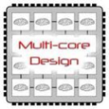
Technology Advances
Cloud applications: data-intensive, compute-intensive, storage-intensive
Bandwidth
WS
Services interface
Web-services, SOA, WS standards
VM0
VM1
VMn
Storage Models: S3, BigTable, BlobStore, ...
Virtualization: bare metal, hypervisor. …
Multi-core architectures
64-bit processor

Slide 6
What is Cloud Computing?
Cloud Computing is a general term used to describe a new class of network based computing that takes place over the Internet,
basically a step on from Utility Computing
a collection/group of integrated and networked hardware, software and Internet infrastructure (called a platform).
Using the Internet for communication and transport provides hardware, software and networking services to clients
These platforms hide the complexity and details of the underlying infrastructure from users and applications by providing very simple graphical interface or API (Applications Programming Interface).

Slide 7
What is Cloud Computing cont.…
In addition, the platform provides on demand services, that are always on, anywhere, anytime and any place.
Pay for use and as needed, elastic
scale up and down in capacity and functionalities
The hardware and software services are available to
general public, enterprises, corporations and businesses markets

Slide 8
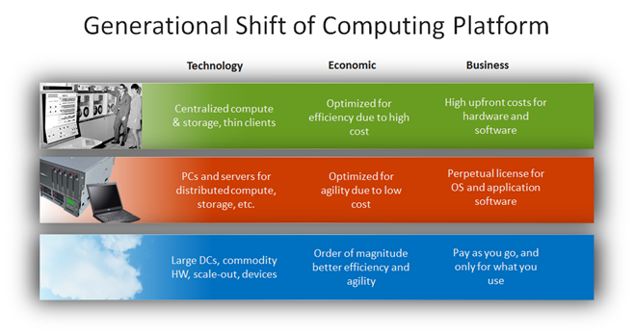
Drivers for the new Platform
http://blogs.technet.com/b/yungchou/archive/2011/03/03/chou-s-theories-of-cloud-computing-the-5-3-2-principle.aspx

Slide 9
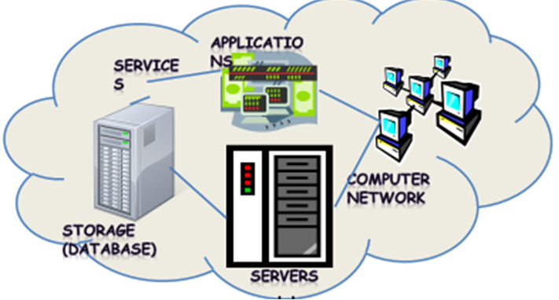
Cloud Summary
Shared pool of configurable computing resources
On-demand network access
Provisioned by the Service Provider

Slide 10
Cloud Summary…
Cloud computing is an umbrella term used to refer to Internet based development and services
A number of characteristics define cloud data, applications services and infrastructure:
Remotely hosted: Services or data are hosted on remote infrastructure.
Ubiquitous: Services or data are available from anywhere.
Commodity model: The result is a utility computing model similar to traditional that of traditional utilities, like gas and electricity - you pay for what you would want!

